Slide 1

Apollon Style Guide

Slide 2
Cores
#ffd375
#ffb97a
#93b1cb
#568f6a
#8fe094
#ffc546
#ffa24e
#85a7c5
#428157
#81dc87
#ffbe2f
#ff9638
#789ebf
#006b3f
#73d97a
#ffb719
#ff8b22

Slide 3
Cores
Cores Primárias
#568f6a
#8fe094
#ffa24e
Cores Secundárias
#ffb97a
#006b3f
#85a7c5
Sucesso
Erro
Cores de Feedback
#81dc87
#bf3a15

Slide 4
Tipografia Principal
Aa
Aa
ABCDEFGHIJKLMNOPQRSTUVWXYZ
abcdefghijklmnopqrtsuvwxyz
1234567890
ABCDEFGHIJKLMNOPQRSTUVWXYZ
abcdefghijklmnopqrtsuvwxyz
1234567890
Noto Sans Regular
Noto Sans Italic

Slide 5
Tipografia Principal
Aa
Aa
ABCDEFGHIJKLMNOPQRSTUVWXYZ
abcdefghijklmnopqrtsuvwxyz
1234567890
ABCDEFGHIJKLMNOPQRSTUVWXYZ
abcdefghijklmnopqrtsuvwxyz
1234567890
Noto Sans Bold
Noto Sans Bold Italic

Slide 6
Tipografia Alternativa
(Web Safe)
Aa
Aa
ABCDEFGHIJKLMNOPQRSTUVWXYZ
abcdefghijklmnopqrtsuvwxyz
1234567890
ABCDEFGHIJKLMNOPQRSTUVWXYZ
abcdefghijklmnopqrtsuvwxyz
1234567890
Lato Normal
Lato Italic

Slide 7
Tipografia Alternativa
(Web Safe)
Aa
Aa
ABCDEFGHIJKLMNOPQRSTUVWXYZ
abcdefghijklmnopqrtsuvwxyz
1234567890
ABCDEFGHIJKLMNOPQRSTUVWXYZ
abcdefghijklmnopqrtsuvwxyz
1234567890
Lato Bold
Lato Bold Italic

Slide 8
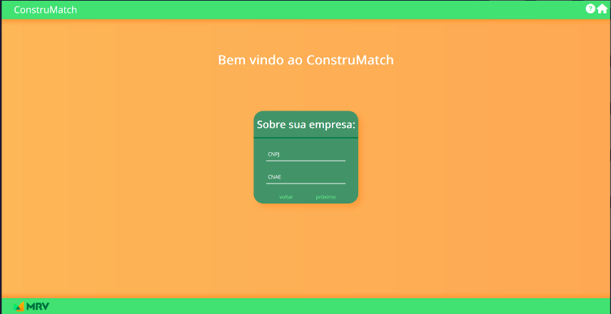
Exemplo de aplicação da tipografia
Noto Sans Regular

Slide 9
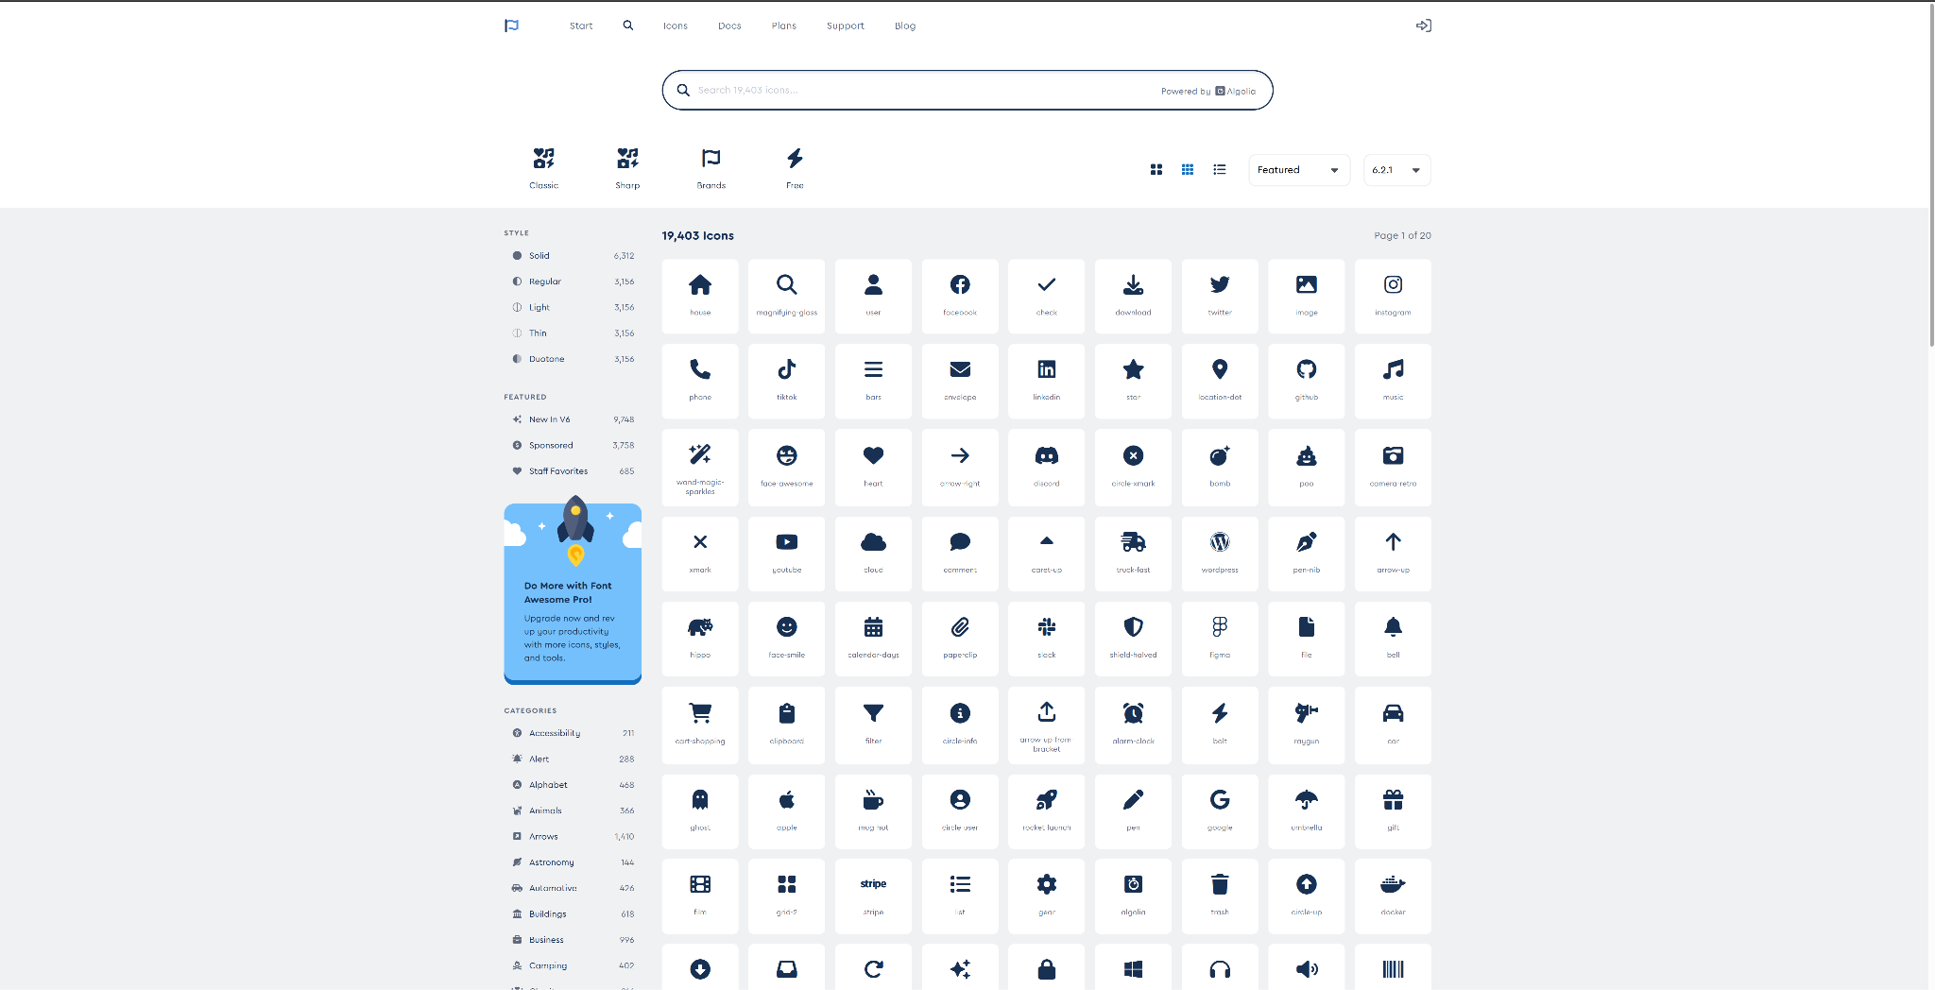
Ícones
https://fontawesome.com

Slide 10
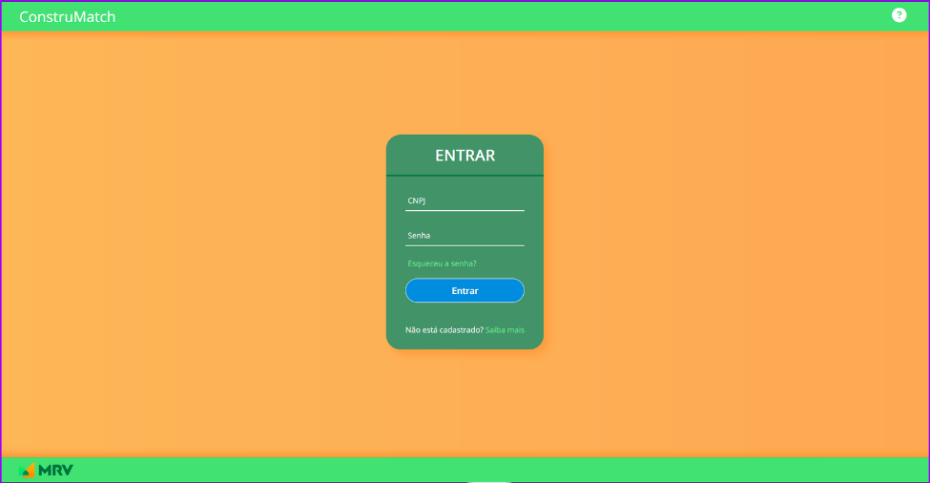

Exemplo de aplicação dos ícones

Slide 11

Exemplo de aplicação dos ícones

